Slide 1
:D

Slide 2
Announcements
Final Projects due tonight at 11:59pm! (we’re going to close the form, so please don’t be late)
Final Presentations this Wednesday!
Prizes :’)
But you’re all winners
Last Lecture rn!
Mental Health Resources — Stressful & Demanding Times
Drop-In Counseling @ Cesar Chavez Center
UHS Emergency/Crisis Resources

Slide 3
Next Steps: The Design Industry & Getting a Job
Week 12

Slide 4
My last lecture :’) (as instructor)

Slide 5
Today’s Agenda
Industry Overview
How to get a … Job
Recruiting Structure
Talking to Recruiter & Designers
Wrap up & AMA (again)
(thank you to Ryan Rodriguez and Faye Han, prev WDD alum BI alum for creating the foundations of this lecture)

Slide 6
Part 1: The Design in Industry

Slide 7
What you can do
Interaction Designer
Front End Developer
Early in Process
Later in Process
UX Researcher
Visual Designer
See also: Product Designer, Product Manager

Slide 8

Or, why not both? / Porque no los dos?

Slide 9
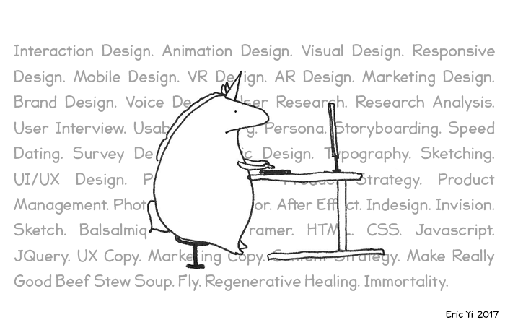
Or, why not both? / Porque no los dos?

Slide 10
Where you can work
Tech Company (in-house design team)
Big
Facebook, Google, Adobe, etc.
Unicorn Startups/Mid-sized
Airbnb, Slack, etc.
Startup
Blend, Medium, anything
Design Agency/Firm
IDEO
Uneo
Frog Design
Instrument
… etc. etc.

Slide 11
Part 2: Getting the Job

Slide 12
Reminder
You are more than your job, GPA, salary, and role!

Slide 13
General Recruitment Structure

Slide 14

0a. Decide on what you want
Figure out your interests, have genuine interest (hopefully)

Slide 15
this is where i go life coach on u

Slide 16
0a. Decide on what you want (sorry it’s gonna get existential up in here)
Access your strengths and interests
What part of the process do you enjoy the most?
What are you best at?
Talking to folks and understanding their pain points (User Researcher)
Designing components and visual design (UI Designer/Graphic Designer)
Putting pieces together and creating experiences (Interaction designer/UX designer/Service designer)
Generalist — love it all (Product Designer)
Generalist but want to touch business, strategy, and technical sides (Product Manager)

Slide 17
0a. Decide on what you want (sorry it’s gonna get existential up in here)
What do you want to get out of your experience?
What do you want to learn, specifically?
Write down your goals
What kind of work environment do you want to be in?
Tech Corporations
Fab perks, lots of interns
Tech guilt lmao
Startups
More responsibility, ownership
Tight-knit community
Agency
Variety of work
Difficult to get, secretive, demanding af

Slide 18

0b. Show your best self
Polish your resume and portfolio

Slide 19

1. Online Application + Cold Email
Applying online (cofolios.com/internships), Googling, etc. Cue Linkedin Stalking

Slide 20

2. Phone Screen
Making sure you’re not a robot™

Slide 21
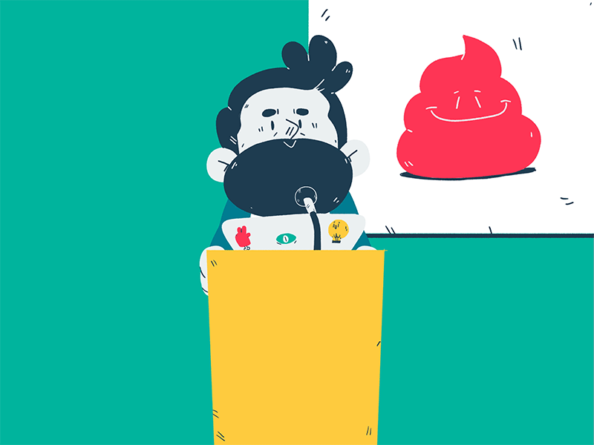
3. Portfolio Review
Show your best work (and self)

Slide 22

4. Design Challenge
App Crit, Take Home, Whiteboard Challenge

Slide 23
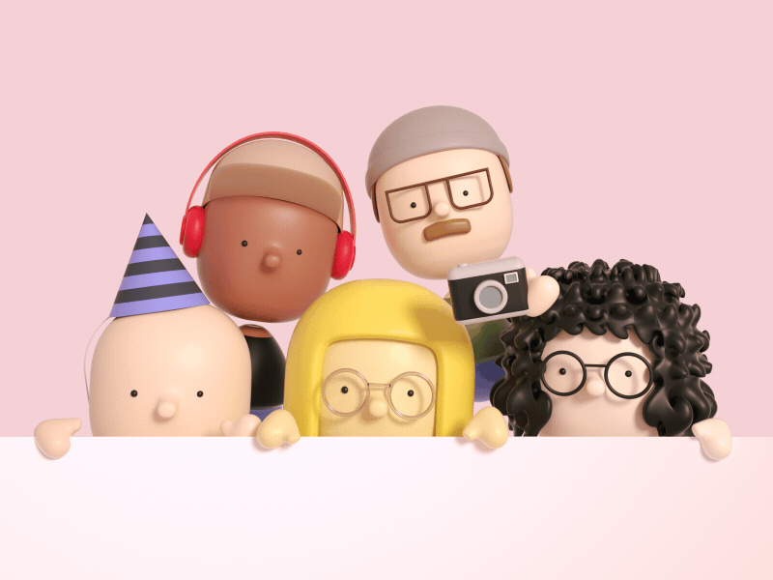
5. Onsite (more)
A combination of aforementioned, speaking 1:1 w/ designers, behavioral interviews (AKA, don’t be a robot, show and have genuine interest in the company)

Slide 24
Communicating w/ Recruiters & Designers

Slide 25
Talking to a Recruiter
Ask about internship positions
Gas yourself up!
What have you done at Berkeley? What’s your involvement in design?
Sell yourself bc we’re not a design school
Talk about how much you love the company
Educate yourself about company’s mission (a lot of people don’t do this lmao)
How does company’s motivation align with yours?

Slide 26
Talking to a Designer
Learn more about what their role
Ask about their journey
What is their interested/investment in where they work?
Learn more about them
How did they get to where they are today?
What they’re interested in about the product
Learn more about design culture at their company
Stalk their socials and understand who they are (personally)
Designers love twitter :’) try to make a connection. Like their tweets lmao
Be … interested!

Slide 27
Example Questions — Recruiter
What does the structure of the internship program look like?
What kinds of projects will I be able to work on?
What does the company do internally? (hackathons, off-sites, etc.)
What does the application process look like?
How many rounds, design challenges, etc.?

Slide 28
Example Questions — Designer
How did you get into design?
What is the most challenging part about designing at Company X?
What part of the product do you touch in your daily work?
What does your day-to-day look like?
Advice for me? (entry-level)
Any questions you got from getting to know their socials

Slide 29
Afterwards...
Thank them! Email or DM on socials (use your best judgement as to which is appropriate)
Summarize what you learned
Next Steps
Keep in touch!

Slide 30
The benefit of being a student

Slide 31
Wrap up — in summary...
Be yourself
Make friends!
Get involved (if you haven’t already)
Reach out to people in industry, they’ll like you bc you’re YOUNG and they were once YOUNG as well

Slide 32
Queue&A (Ask me literally anything)

Slide 33
Questions y’all submitted
- We can do a lot on the Frontend it appears, so what do Backend developers do at their basics?
- What are the job prospects like? I have always thought a job as a designer was rare but how true is that? And do most people come in as designers or move from engineering/marketing to design roles?
- Given that I’m not planning to be a designer, which industries desire design skills “on the side”?
- Do you have any advice for getting into Front-end for someone who is just starting out but about to graduate?
- What’s the biggest challenge you’ve faced going into design?
- What is the interview process like for frontend?
- What are certain products/projects you’ve specifically worked on and deployed?
- How does a front-end developer best deal with positioning and sizes, since a website must always be scalable throughout many devices?
- What are some of the hardest design interview questions?

Slide 34
Questions y’all submitted
- We can do a lot on the Frontend it appears, so what do Backend developers do at their basics?
- What are the job prospects like? I have always thought a job as a designer was rare but how true is that? And do most people come in as designers or move from engineering/marketing to design roles?
- Given that I’m not planning to be a designer, which industries desire design skills “on the side”?
- Do you have any advice for getting into Front-end for someone who is just starting out but about to graduate?
- What’s the biggest challenge you’ve faced going into design?
- What is the interview process like for frontend?
- What are certain products/projects you’ve specifically worked on and deployed?
- How does a front-end developer best deal with positioning and sizes, since a website must always be scalable throughout many devices?
- What are some of the hardest design interview questions?

Slide 35
Questions y’all submitted
What are the job prospects like? I have always thought a job as a designer was rare but how true is that? And do most people come in as designers or move from engineering/marketing to design roles?
Given that I’m not planning to be a designer, which industries desire design skills “on the side”?
What’s the biggest challenge you’ve faced going into design?
What are some of the hardest design interview questions?

Slide 36
Questions y’all submitted - pt2
What resources can I use to continue learning after this class?
What do you do when you hit a wall? I find it personally hard to progress and I find myself staring at whatever I have with no progress.
How competitive is it to get a solid design job at one of the leading tech companies? Do most of these people come from art or visual media type backgrounds?
What are some design projects that we can do just on our own? How do you recommend we get into design?
What are some organizations on campus to join?
Why did you get into web design?

